Slide 1
Testing Session-7

Slide 2
Agenda
Different Test Execution Status
Bug Triage Meeting/DRM
Bug Reporting
Severity and Priority
Bug Life Cycle
Bug Status
Testing Principles

Slide 3
Different Test Execution Status
Pass
Fail
Blocked
Differed
Not Applicable(NA)
Not Completed

Slide 4
Bug Reporting
Identify Genuine bugs
Clear steps to reproduce
Avoid duplicate defects
Screen shot

Slide 5
Severity & Priority
Levels of severity → Priority
Blocker P0
Very high P1
High /Major P2
minor P3

Slide 6
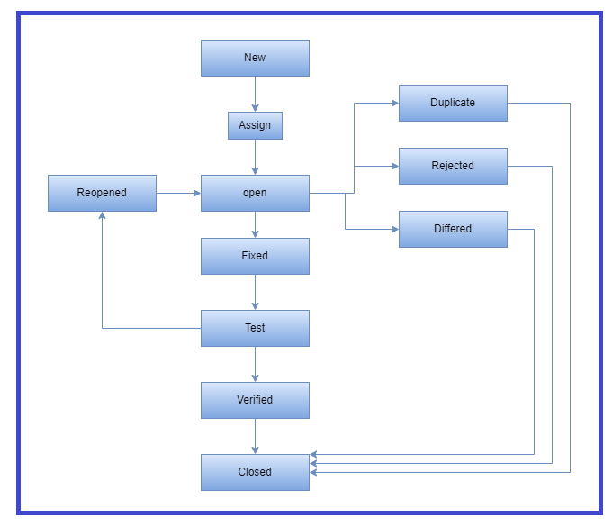
Bug Life Cycle

Slide 7
Severity(High, Low) And Priority(High, Low)
Examples of
High Severity, High Priority
High Severity, Low Priority
Low Severity, High Priority
Low Severity, Low Priority

Slide 8
Why Swhizz?
Following the project-oriented training By working on user stories
Real time people will deliver the classes
Hands on experience.
One to One monitoring
Interaction sessions
Doubts Clarification Session
Expertise in resume preparation
Mock interviews
Job assistance
Associated with 50+ Clients
900+ students got placed

Slide 9

Any Queries?

Slide 10
Thank You
Mr.SubbaRao (Relationship Manager)
Contact:9059002244

